Slide 1
Shiny Dashboard Project
Farouk Abdel-Magied

Slide 2
Problem Statement – Going Back in Time to 2015
Safest Borough?
Safest District?
Where Should I live??
London

Slide 3
Choosing the Dataset
What should the data set include?
UK crime data that is specific to London
The data should cover a range of years leading up to 2015
The crime data should be divided into different London boroughs and districts.
The crime data should be also divided into different crime types
Data Set Used:
Mayor Of London Database – London Datastore
Link for the data:
https://data.london.gov.uk/dataset/recorded_crime_rates
The data was found to include

Slide 4
Data Preprocessing

Slide 5
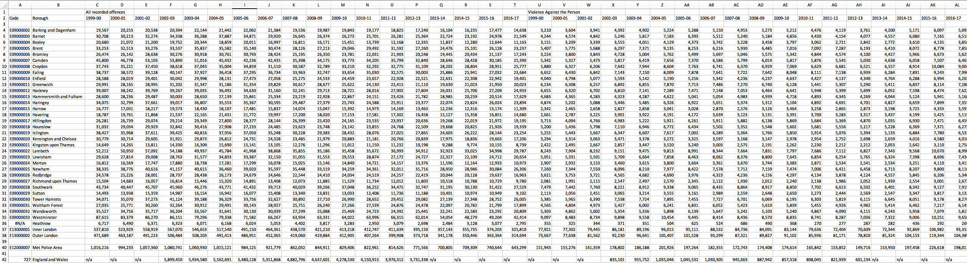
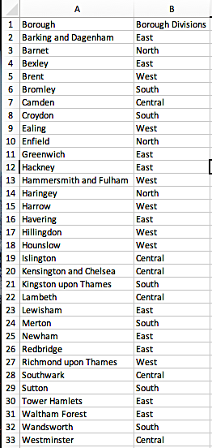
Original Dataset Format (csv)
Original Data Set: A
Final Dataset
Original Data Set: B

Slide 6
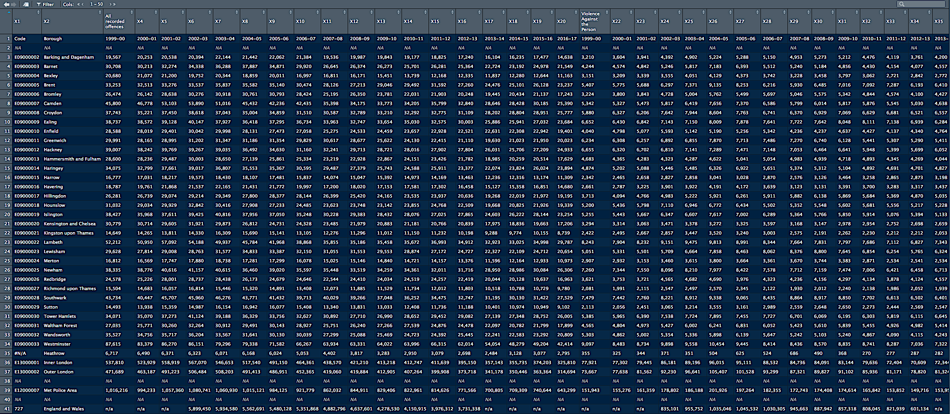
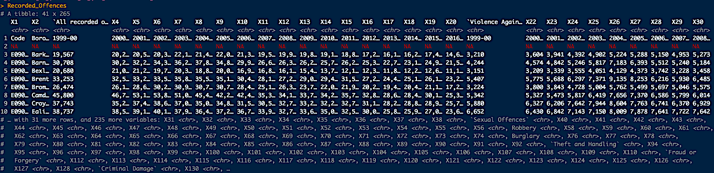
Original Dataset Format (R)
Original Data Set
Final Data Set – What we want to work with

Slide 7
Data Cleaning and Preprocessing

Slide 8
1
Data Cleaning Steps: 1 & 2
Output 1
2
Output 2

Slide 9
3
Data Cleaning Steps: 3 & 4
Output 3
4
Output 4

Slide 10
5
Data Cleaning Steps: 5 & 6
Output 5
Output 6
6

Slide 11
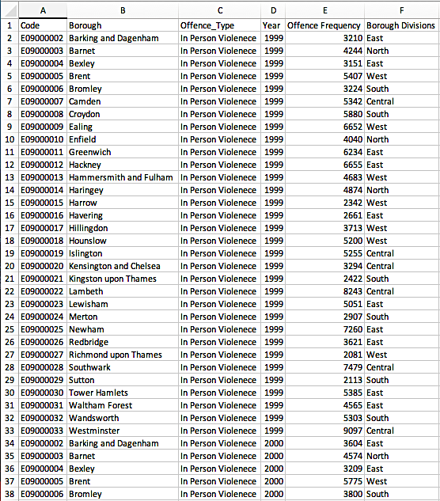
Data Cleaning Step: 7
Output 7
7
Final Data Output
Now we can start looking and working with our data

Slide 12
Data Visualizations

Slide 13
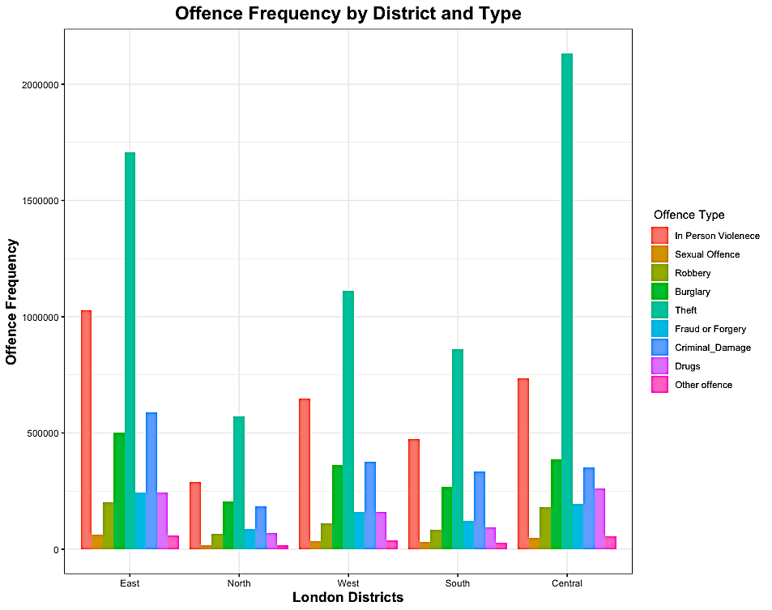
Number of Offence in Each District by Type of Offence – Bar Chart

Slide 14
Offence Frequency By Year and London District – Line Chart

Slide 15
Offence Frequency By Type vs. Time – Line Chart

Slide 16
Ratio of Type of Offence to total Offences vs. Time

Slide 17
Offence Frequency by Type and by District Location Vs. Time

Slide 18
Shiny App

Slide 19
Offence Frequency by Type Vs. Time
Server
ui

Slide 20
Offence Frequency by Type and District Vs. Time
Server
ui

Slide 21
Ratio of Type of Offence to total Offences vs. Time
Server
ui

Slide 22
Offence Frequency By Year and London District
Server
ui

Slide 23
Offence Frequency By Year and London Borough
Server
ui

Slide 24
Shiny App – Tab 1

Slide 25
Shiny App – Tab 2

Slide 26
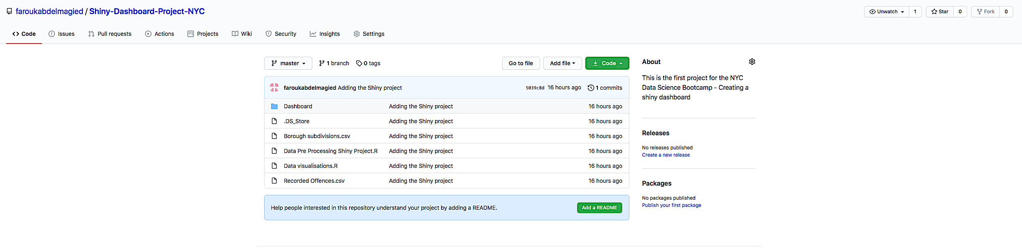
Is this on GitHub?
https://github.com/faroukabdelmagied/Shiny-Dashboard-Project-NYC

Slide 27
Conclusions from the displayed data set
Which London District is the safest and why?
North London has the lowest recorded offences recorded over time.
Theft and In person violence are the two types of crime offences that are on the rise in North London ( In terms of both offence frequency and the ratio of the offence compared to the total).
Which London Borough is the Safest?
Kingston upon Thames – South London
Should I choose to live in:
The Safest district in London – North London
The Safest borough in London – Kingston which is in South London
Other Factors:
Distance to University
Pricing

